Slide 1

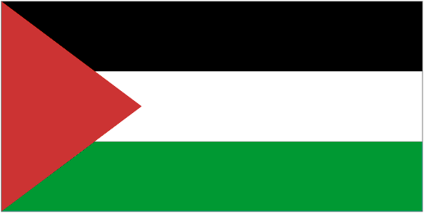


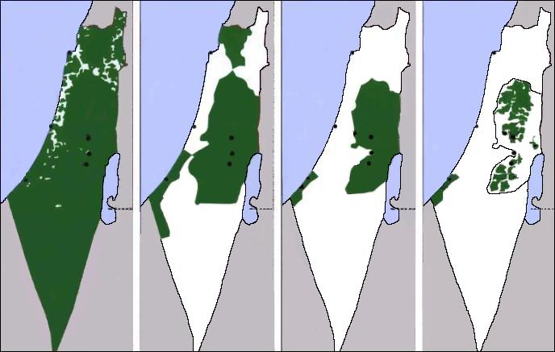
PALESTINE
Super short version
Notes:
To view the presentation press : View / Slide show / From Beginning
To advance the slides press : Page up/down. To close the presentation click on the small window on the corner left-down and then press Exit.
To organize the automatic play of the slides press : Slide Show /Slide Transition / Advance Slide / Automatically after x seconds / Apply to all slides
To prepare a conference see also the notes and comments under the slides,
and read the file "Important" that you find at the beginning of the website www.imparalavita.ch
https://www.un.org/unispal/history/
http://www.awraq.birzeit.edu/en
http://www.plands.org/graphics/index.html
http://en.wikipedia.org/wiki/History_of_Palestine
https://en.wikipedia.org/wiki/Right_of_conquest
Ilan Pappe, The ethnic cleansing of Palestine
Susan Nathan, "The Other Side of Israel", ed. HarperCollins Publishers Ltd.
Shlomo Sand: The invention of the the Jewish people.
Norman G. Finkelstein: The Holocaust Industry
https://spaces.hightail.com/space/7K0i2/fi-6385ce6d-1449-47f9-a4f3-25a02da48c13/The%20Book.pdf
https://www.akevot.org.il/en/
http://www.badil.org/en/
https://www.ochaopt.org/content/humanitarian-facts-and-figures
Fariss Wogatzki: "Nobody should say he didn't know!"
National song
https://www.youtube.com/watch?v=8lvM2tfOdnM
This presentation can be downloaded for free and in 5 languages here: http://www.imparalavita.ch/eng/palestine_history.html

Slide 2
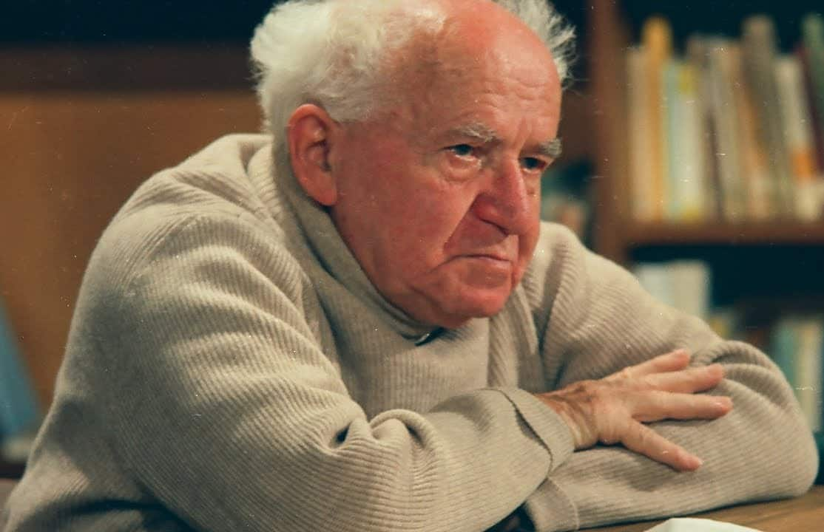
"We will drive out the Arabs and
take their place.”
A classic case of settlement colonisation
Ben Gurion 1886 - 1973
Prime Minister of Israel
1948 - 1953 and 1955 - 1963
*Ben Gurion's letter written in 1937 to his son.
Notes:
The specious justifications put forward by Zionists:
Anti-Semitism - The Jewish people have always been persecuted (e.g. pogroms) so they must have a place to stay in safety
Historical right - Palestine was inhabited by Jews so it belongs to the Jews - Palestine was uninhabited
Divine right - Palestine was promised by God to the Jews; the Jews are the Chosen People.
Balfour Declaration, UN 181, etc. etc.
https://www.palestineremembered.com/David_Ben_Gurion_To_His_Son_Amos_Written_OCT_5th_1937.html

Slide 3
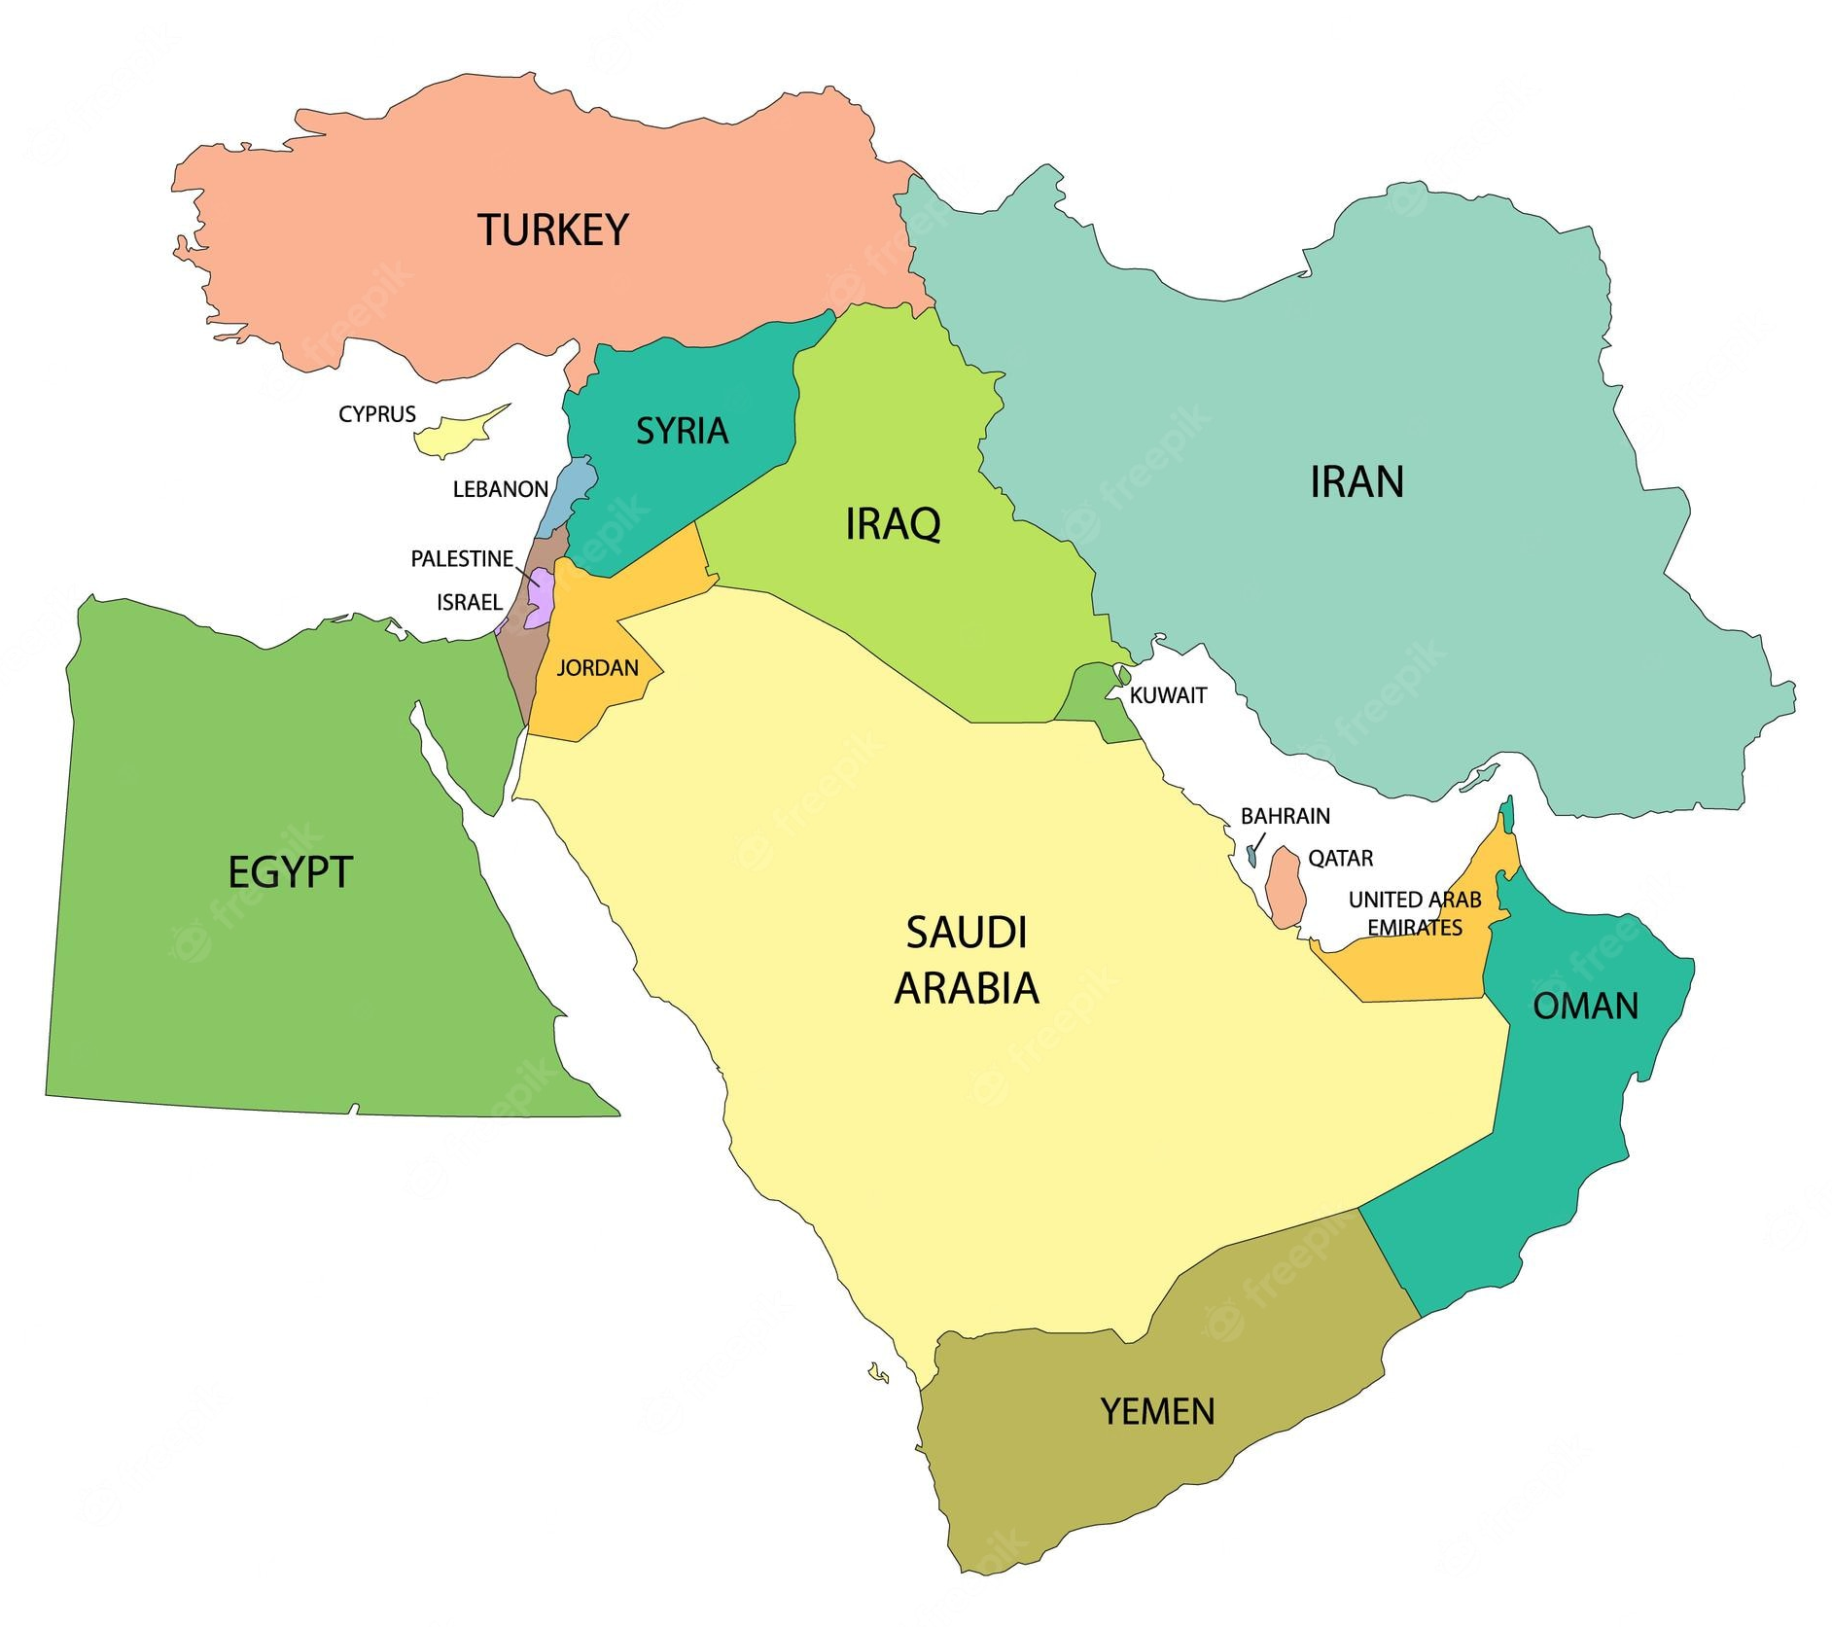
Mediterranean Sea
Palestine is part of the Middle East
PALESTINE

Slide 4
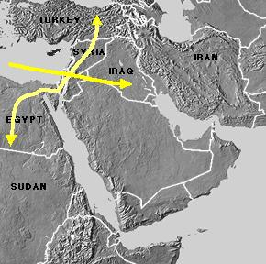
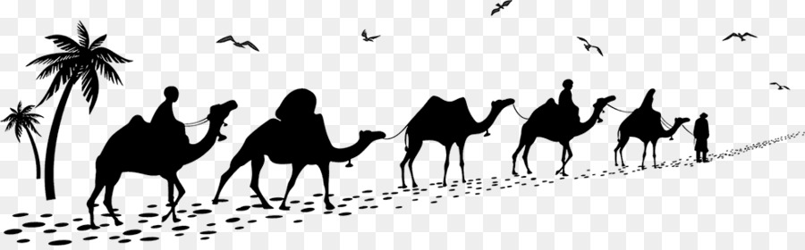
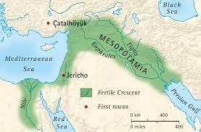
Palestine
Obligatory passage between
- Africa and Asia
- Africa and Europe
- The Mediterranean and the East
ARABIA
Palestine is part of the Fertile Crescent of the Middle East
Notes:
http://en.wikipedia.org/wiki/The_Levant
http://it.wikipedia.org/wiki/Palestina

Slide 5
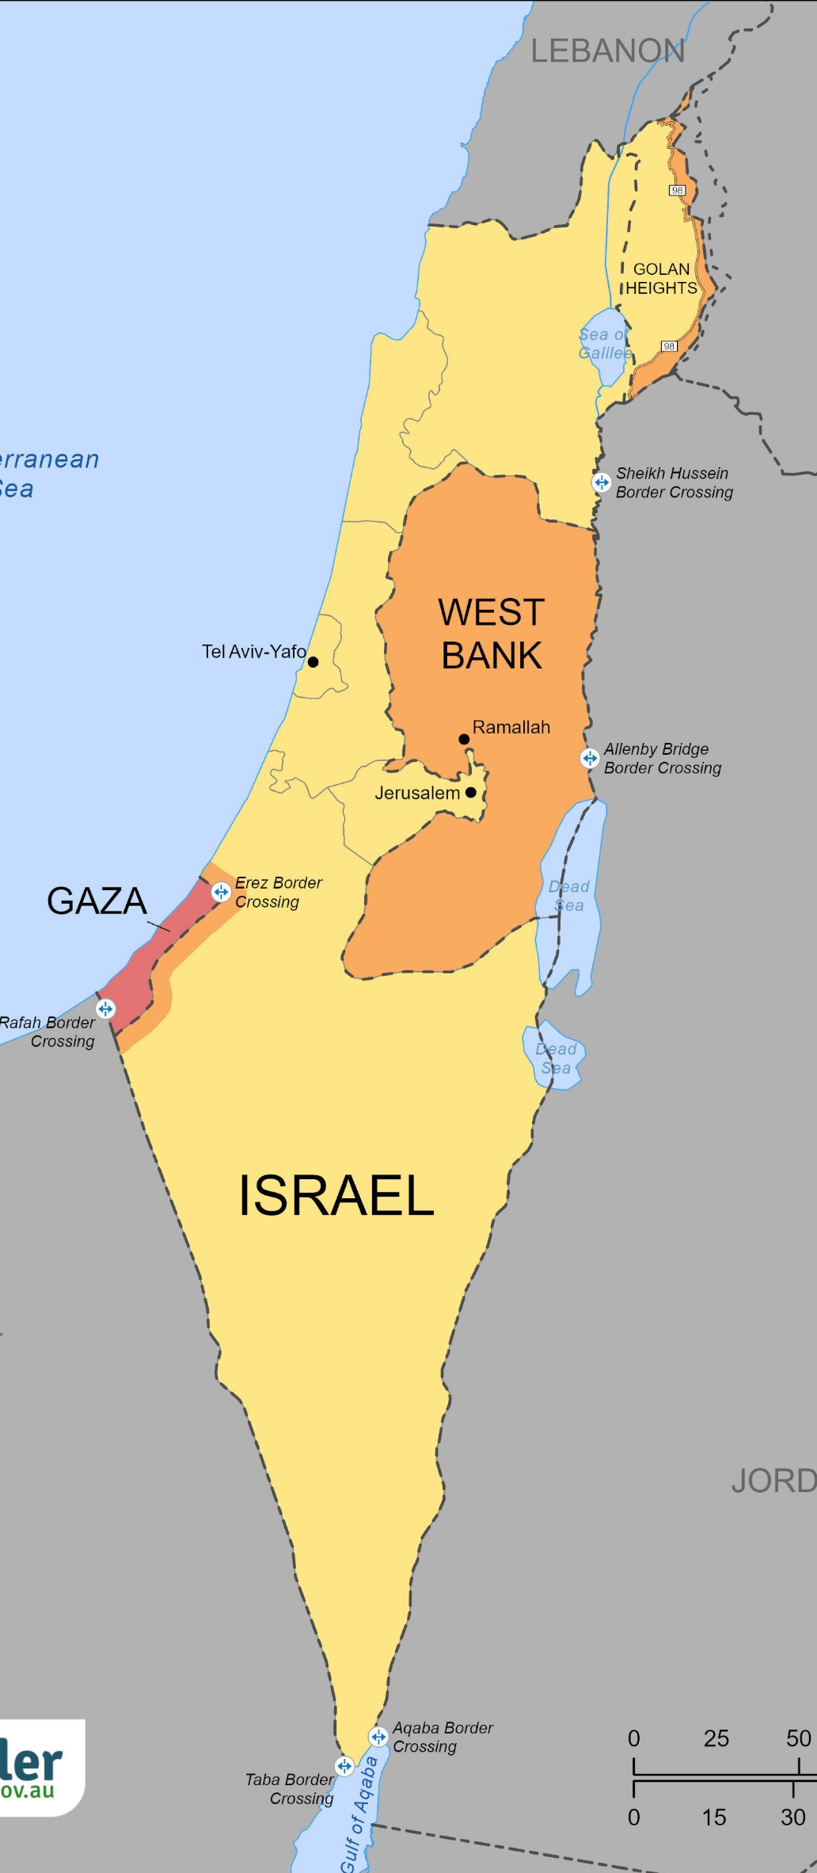
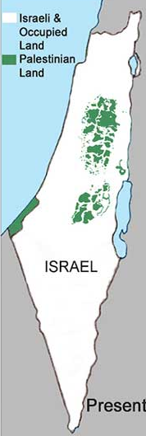
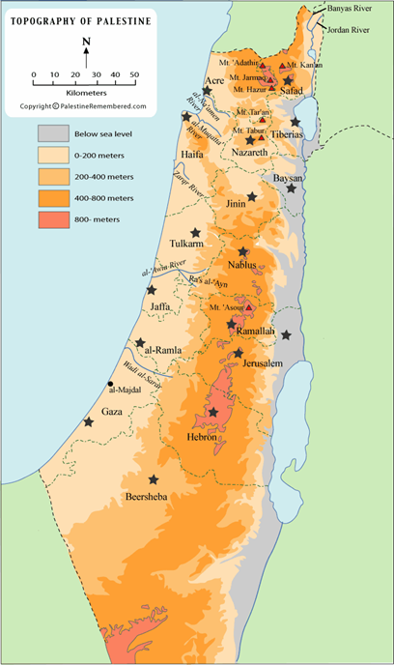
Lebanon
Lebanon
Mediterranean Sea
Mediterranean Sea
Syria
Syria
Jordan Valley
Gaza
Death Sea
Egypt (Sinai)
Jordan
Egypt (Sinai)
Jordan
Geography
PALESTINE
Topography

Slide 6
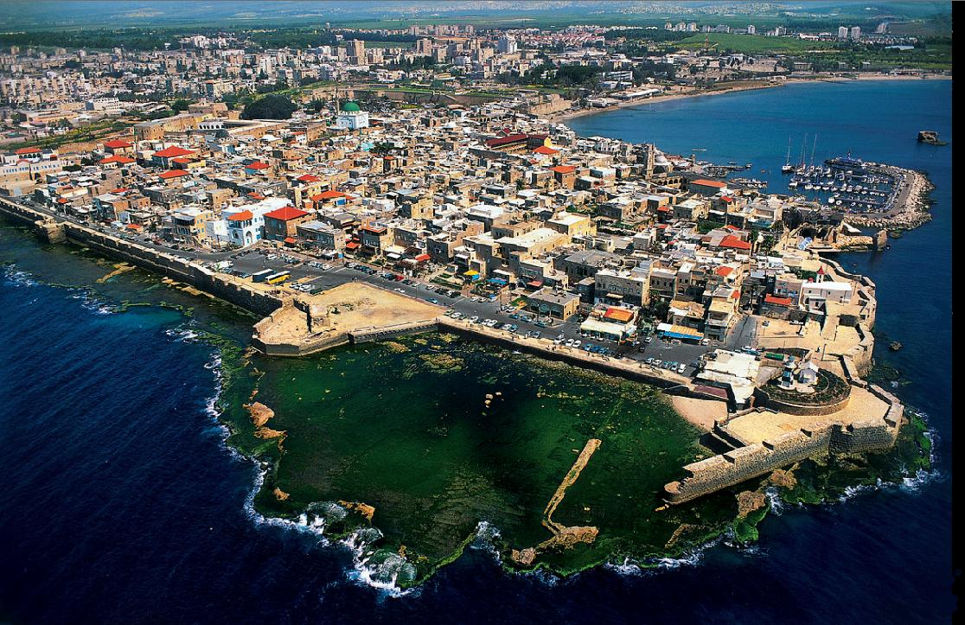
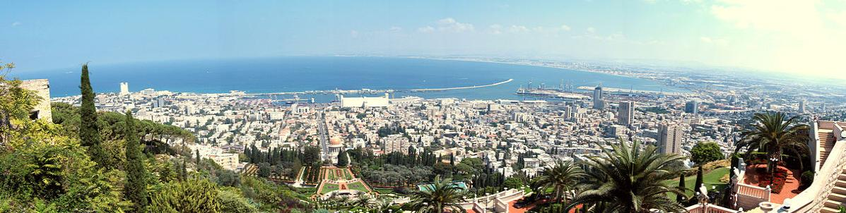
Acres
PALESTINE
Haifa
Notes:
https://it.wikipedia.org/wiki/Acri_(Israele)
https://it.wikipedia.org/wiki/Haifa

Slide 7
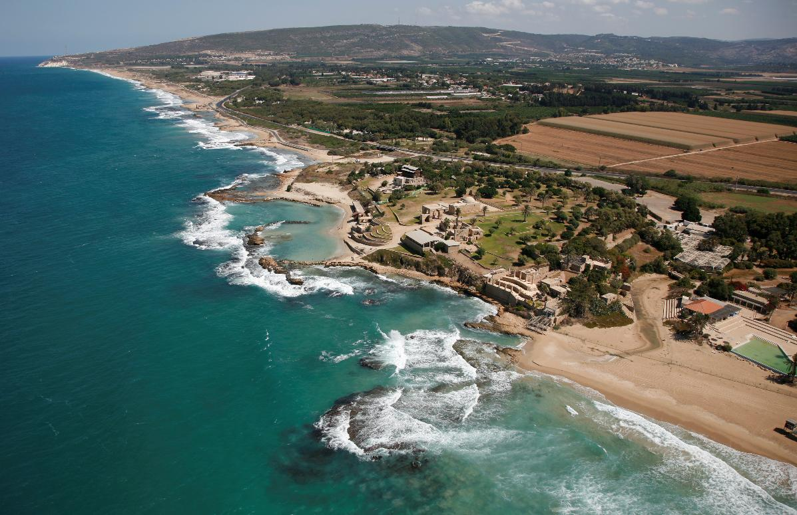
The coast in the north of Palestine
Notes:
.

Slide 8
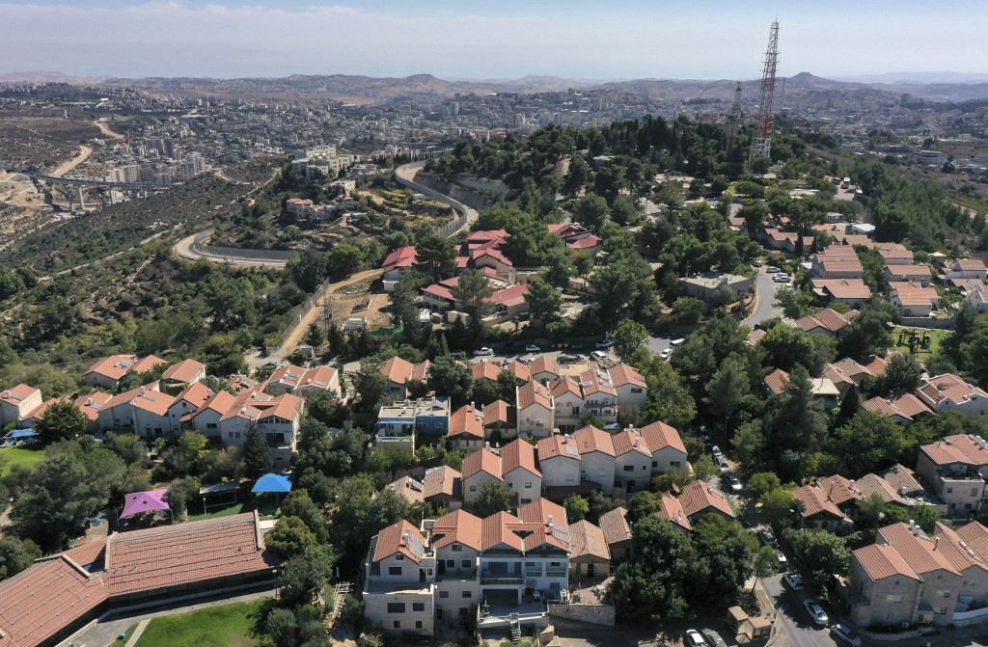
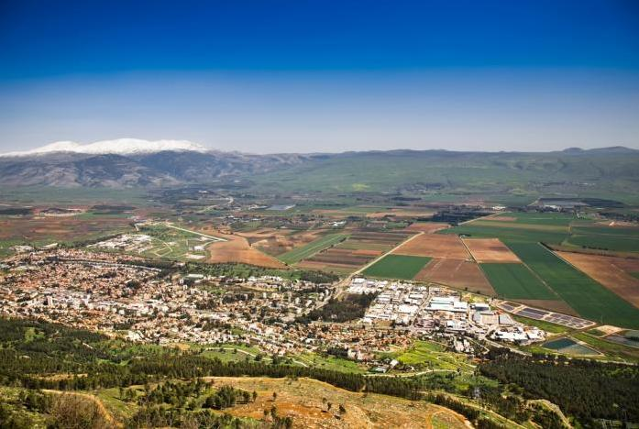
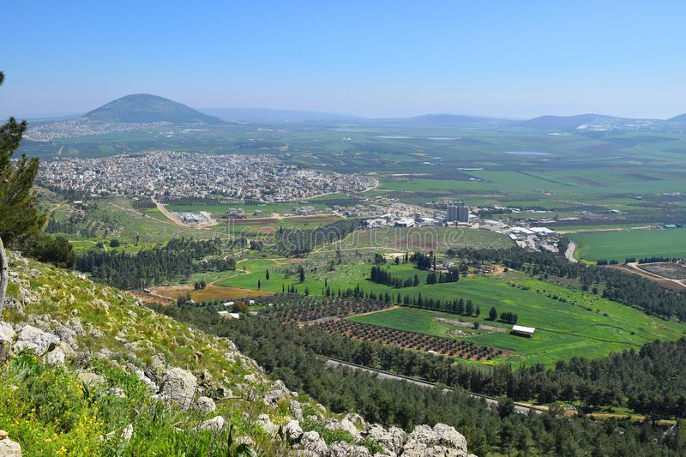
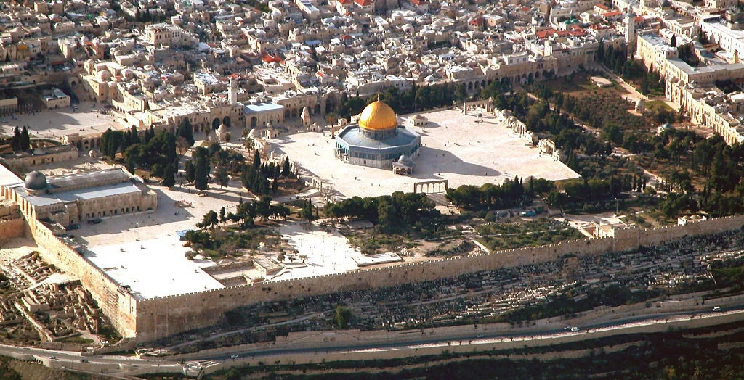
Gerico
The Israeli settlement of Har Gilo, Jerusalem district.
Palestine: a land where milk and honey flows
Jerusalem, the Temple Mount, with the Al Aqsa mosque (left) and the Dome of the Rock (center).
Jezreel valley
Notes:
Exodus 3, 8
http://en.wikipedia.org/wiki/Tantura
https://it.wikipedia.org/wiki/Massacro_di_Tantura
http://it.wikipedia.org/wiki/Gerico
http://it.wikipedia.org/wiki/Armageddon
http://en.wikipedia.org/wiki/Jezreel_Valley

Slide 9
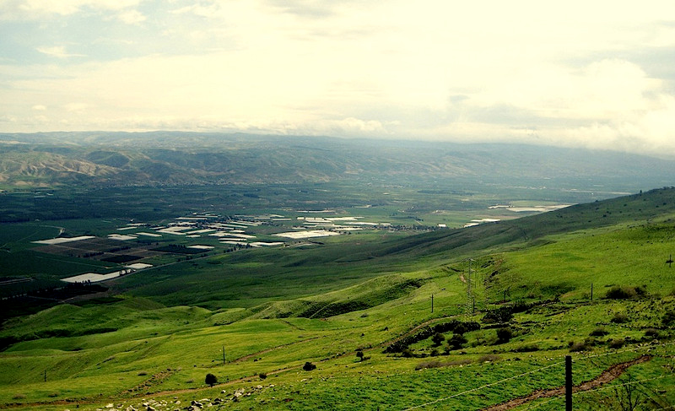
The Jordan Valley, with on the background, the Jordanian plateau.
The white spots are the greenhouses of the Israeli settlements
Notes:
https://en.wikipedia.org/wiki/Jordan_Valley

Slide 10
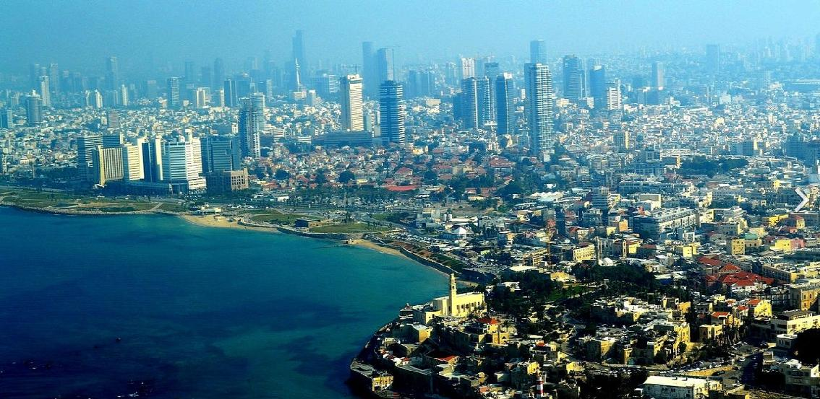
Tel Aviv today
What remains of Jaffa
Notes:
https://en.wikipedia.org/wiki/Tel_Aviv

Slide 11
Cananeans
3000 BC
Egiptians 1488 BC
Philistines
1200 BC
Israelites 1000 BC
Phoenicians 925 BC
Assyrians 733 BC
Babylonians597 BC
Persians
Ciro - 539 BC
Macedonian Alexander the Great 322 BC
Romans 70 BC
Arabs
632 A.D.
Christians 1039 - Crusaders
Mamluks
1253 - Saladin
Ottomans
1516
British
1917
Zionists
1948
The comings and goings in Palestine over the centuries
Notes:
Not mentionned: the Ittites, the Mongols, Napoleon,

Slide 12
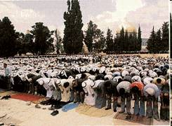
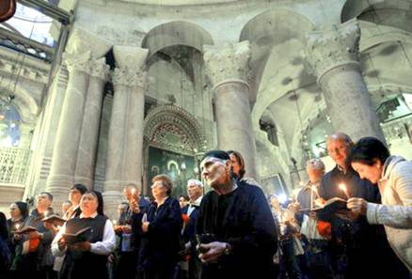
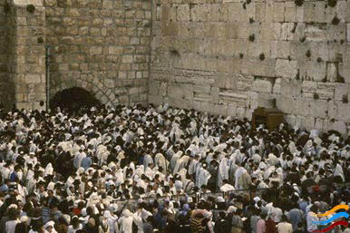






Muslims on the terrace at Al Aqsa
Christian - Holy Sepulcre Church in Jerusalem
Jews at the Wailing Wall in Jerusalem
Palestine: the Holy Land for three important monotheistic religions
Torah Koran Bible
Notes:
http://en.wikipedia.org/wiki/Palestine/Christian
http://en.wikipedia.org/wiki/Haredim
http://en.wikipedia.org/wiki/Wailing_wall
http://en.wikipedia.org/wiki/Torah
http://en.wikipedia.org/wiki/Koran
http://en.wikipedia.org/wiki/Temple_Mount

Slide 13
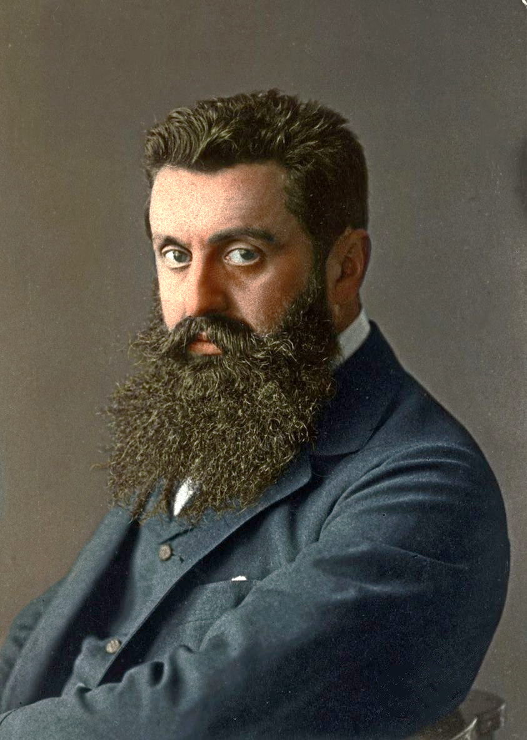
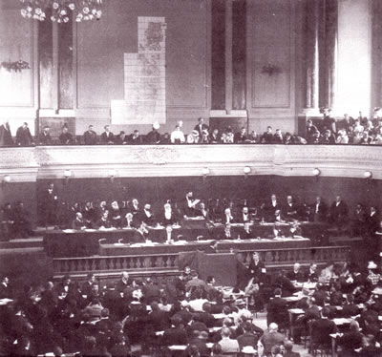

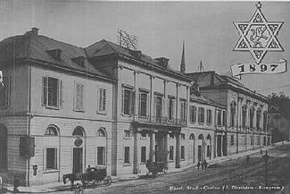
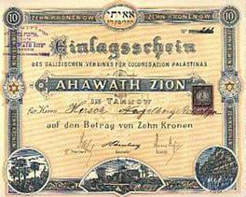
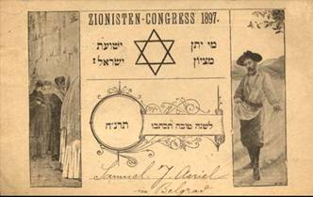
Theodor Herzl
Basel
1897
Basel, the first Zionist congress. The Zionists want to create in Palestine a State for the Jews.
The invitation to the first congress (with Wailing wall)
The contribution certificate
Basel
Notes:
On the first platform the Wailing wall was already embodied : the intention to settle in Palestine and not in an other country was clear since the beginning.
Basel in Switzerland was chosen because, in Germany, Zionism was considered wrong by the majority of Jews.
Theodor Herzl, founder of the Zionist movement talking about the Arabs of Palestine in 1895: "Drive the poor people across the border by refusing them work. The process of expropriation and displacement of the poor must be conducted discreetly and with caution. "
http://en.wikipedia.org/wiki/History_of_Zionism
http://en.wikipedia.org/wiki/Jewish_National_Fund
http://en.wikipedia.org/wiki/Zionism_is_racism
http://en.wikipedia.org/wiki/Haredim_and_Zionism
https://www.routledge.com/Sociological-Knowledge-and-Collective-Identity-S-N-Eisenstadt-and-Israeli/Sinai/p/book/9781138351837
https://www.trtworld.com/magazine/how-theodor-herzl-failed-to-convince-the-ottomans-to-sell-palestine-46991
++++++++++++++++++++++++++++++++++++++++++++++++++++++
www.stopthejnf.org
Since its foundation, the JNF (Jewish National Fund) has been an agency of the Israeli government and the Zionist movement. Many members of the Zionist leadership and the Israeli government are also members of the JNF leadership. The JNF is an instrument of the Zionist colonization of Palestine.
At first, the main task of the JNF was to raise funds to buy land in Palestine for the Zionist settlers. Since the Nakba, the role of the JNF has been to take over real estate stolen from the Israeli army from the Palestinians and to attribute, rent or sell these goods only to Jews and to ensure that these goods remain in Jewish hands forever. In addition, the JNF, using its special brigades, organized the abolition of the Arab character of Palestinian villages and communities by demolishing Arab buildings (e.g. the Arab market in Haifa) and erecting Zionist settlements, buildings or parks in their place, which have a Jewish character and are reserved for the Israelis. This to Judaize Jerusalem and Palestine.

Slide 14
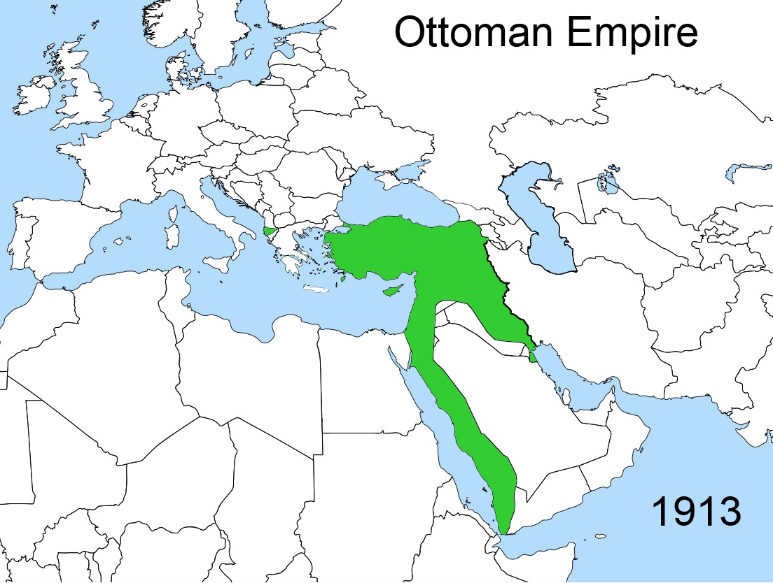
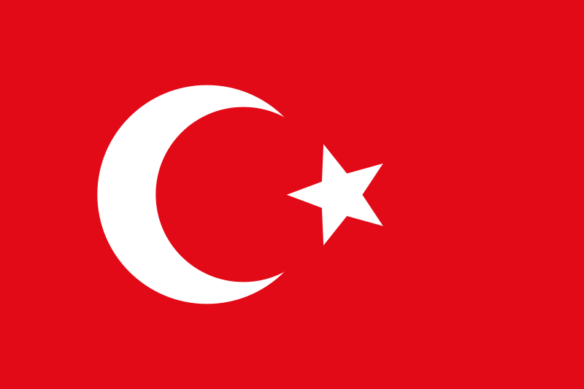
1917 - Palestine is part of the Ottoman Turkish Empire

Slide 15
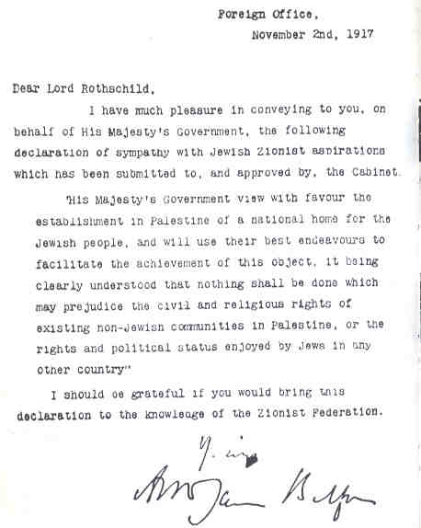

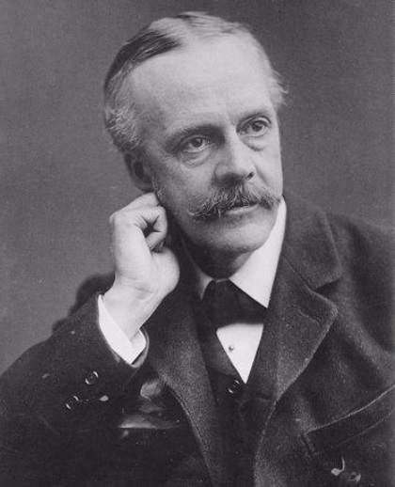
1917
The Balfour Declaration
The British government declares itself favourable to the establishment in Palestine of a «national home» for the Jews.
Lord Balfour
Notes:
The Balfour Declaration was suggested to Lord Arthur James Balfour by his secretary, a certain Samuel Herbert, Jewish and Zionist ...
With this move, Britain also hoped to procure guardianship for the Suez Canal and a beachhead in the oil-rich Middle East, because with the First World War, oil had become, "strategic.“
According to some historians, Chaim Weizmann and Leopold Amery, a Jewish Zionist in the British Government who wrote the Balfour Declaration in 1917, were also involved in the Balfour statement. Before the final draft, Lord Balfour changed the declaration several times.
The Balfour Declaration was the price Britain paid the Zionists for convincing the US to enter the war against Germany. The Zionists convinced US President Woodrow Wilson that Mexico, helped by Germany, wanted to recapture the Mexican territories that had been lost to the US. That is why the US enters the war against Germany. T the same time, an Jewish English scientist invented a new powerful explosive that could have been used in war: he gave this invention to the British government in return for a promise to allow Zionists to immigrate to Palestine.
http://en.wikipedia.org/wiki/Lord_Balfour
http://en.wikipedia.org/wiki/Balfour_Declaration
http://ifamericaknew.org/us_ints/balfour.html
https://israelpalestinenews.org/wrote-balfour-declaration-world-war-connection/
https://www.jeremyrhammond.com/2018/11/02/how-great-britain-facilitated-the-ethnic-cleansing-of-palestine/
Sahar Huneidi – The hidden history of the Balfour declaration
The Palestinian press already warned of the danger of a Zionist invasion of Palestine and the population started uprising. movements.https://en.wikipedia.org/wiki/Arab_Revolt

Slide 16
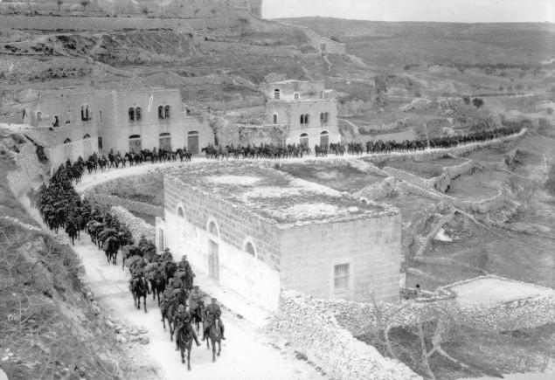
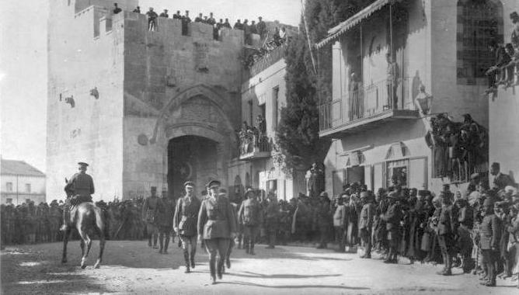
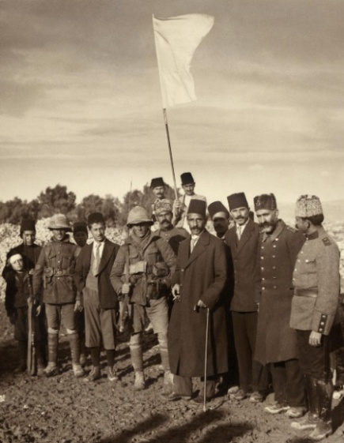
1917 - 1918
British troops conquer Palestine
Arrival of British troops
December 1917 The city of Jerusalem surrenders
British troops led by General Allenby enter Jerusalem
Notes:
From 1917 to 1922, Palestine was governed by General Allenby by military decrees.
http://en.wikipedia.org/wiki/Edmund_Allenby,_1st_Viscount_Allenby

Slide 17
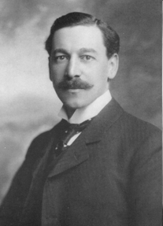
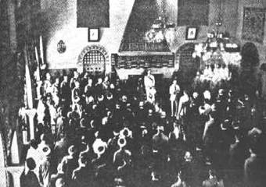
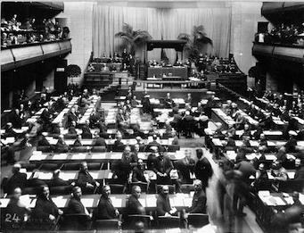
1922
The League of Nations entrusts the administration of Palestine to Great Britain
First Commissioner is the Zionist Samuel Herbert
Samuel Herbert
1920 Appointment of Samuel Herbert Commissioner for Palestine
1919 1. session of the League of Nations
Notes:
As first administrator of Palestine, Samuel Herbert favored the Jews and their businesses in every possible way (for example, tax exemptions and tax breaks for Jewish businesses, the introduction of Hebrew and English as official languages in Palestine, allocation of state or unclaimed land to the Jews, brutal repression of any Arab resistance, tolerance of a Jewish militia, etc..) and at the same time he gave to the Arabs and their businesses all difficulties imaginable (even the obligation to pay taxes due to the 'Ottoman Empire, for which the Arabs had to sell their own lands to the Jews.).
League of Nations : For the first time in the history of humanity a supranational organism makes Decisions Concerning Whole Peoples and Nations.
http://en.wikipedia.org/wiki/San_Remo_conference http://en.wikipedia.org/wiki/Herbert_Samuel http://en.wikipedia.org/wiki/British_Mandate_of_Palestine
http://en.wikipedia.org/wiki/Palestine_Mandate
https://en.wikipedia.org/wiki/League_of_Nations
https://en.wikipedia.org/wiki/Herbert_Samuel,_1st_Viscount_Samuel
"MANDATED LANDSCAPE: BRITISH IMPERIAL RULE IN PALESTINE, 1929–1948" by Roza I.M. El-Eini (2006)

Slide 18
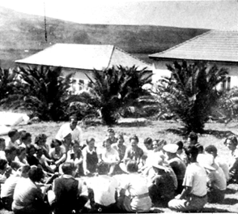
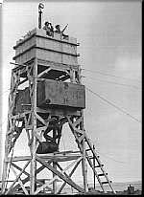
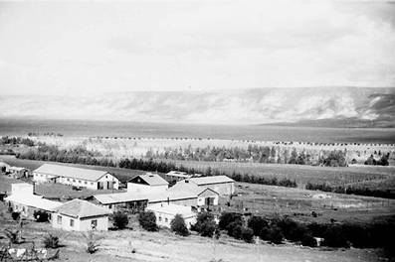
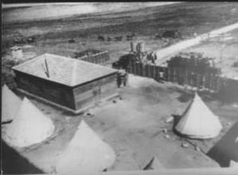
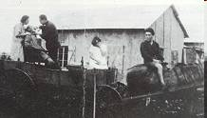
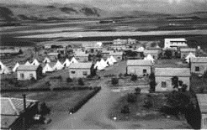

1934 Kibbutz Degania Alef
Kibbutz Dalia 1930s
Mobile dental care
1928 Kibbutz Beit Hashita
In Palestine kibbutz grow like mushrooms
Kibbutz Bet Alfa 1921
Notes:
http://en.wikipedia.org/wiki/Kibbutz

Slide 19
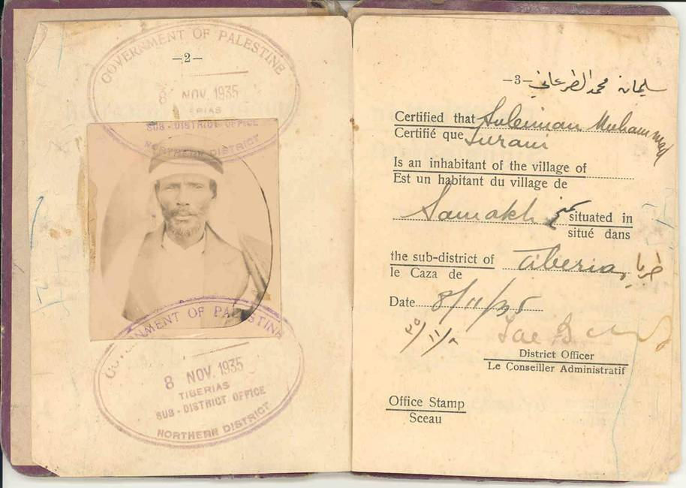
Palestinian identity document from 1935
Notes:
Note the stamp: Government of Palestine.

Slide 20
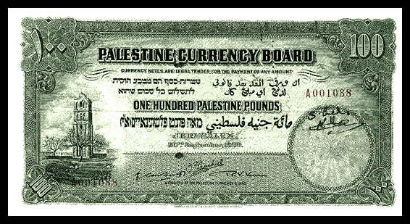
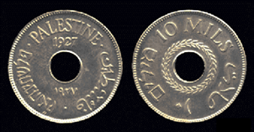
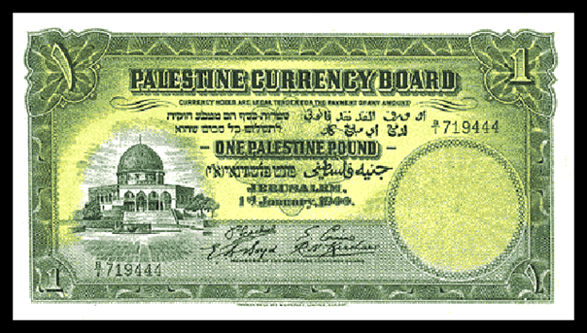
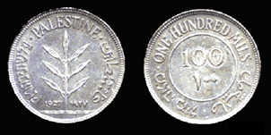
Some Palestinian notes and coins from the British Mandate period
In Palestine, these means of payment were put out of circulation by the Zionists in 1948.
Notes:
. http://en.wikipedia.org/wiki/Palestine_pound

Slide 21
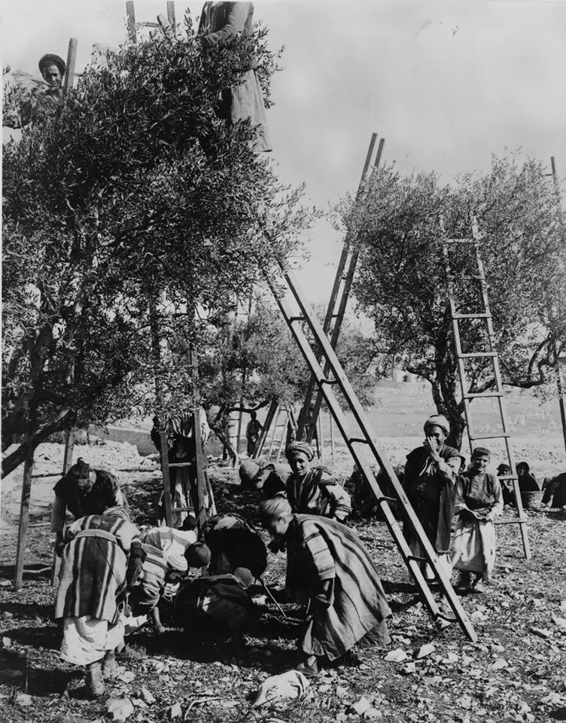
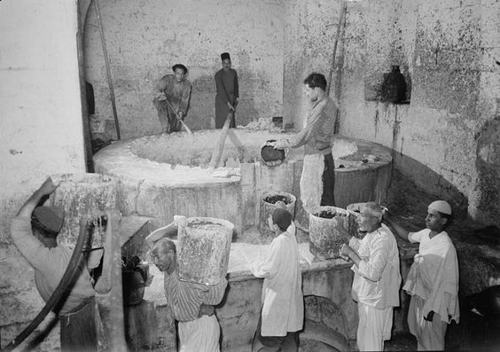

1927 - Nablus, soap produktion
1936 - Olive, oil and soap industry in Palestine
Notes:
http://en.wikipedia.org/wiki/Nabulsi_soap

Slide 22




General view of the citrus groves of Jaffa before 1914
The Palestinians citrus groves
In Palestine, the Arabs developed citrus cultivation.
Later it was almost all confiscated by the Zionist Jews.
Notes:
On their arrival, the Zionist Jews learned from the Arabs how to cultivate citrus fruits. Later the Jews stole the citrus groves of the Arabs.
http://en.wikipedia.org/wiki/Jaffa_orange
https://www.haaretz.com/.premium-the-forgotten-story-of-the-original-jaffa-oranges-1.5372705

Slide 23




1933 The British repression
1930 The Palestinian Committee of Salvation
1929 - 1939 Great Arab revolt (repressed by the British helped by the jewish militias)
23
1929 Arab protest demonstration
1938 - The infamous Special Night Squad, death squadron formed by British and Zionists
Notes:
http://it.wikipedia.org/wiki/Moti_palestinesi_del_1920
http://en.wikipedia.org/wiki/1929_Palestine_riots
http://en.wikipedia.org/wiki/Arab_riots_of_1936

Slide 24




Punitive Demolition
Collective arrest, Jerusalem, September 1938
THE REPRESSION
Imprisonments
Checkpoint
Notes:
http://en.wikipedia.org/wiki/Defence_(Emergency)_Regulations
http://en.wikipedia.org/wiki/British_Mandate_Palestine

Slide 25



1937 piano Peel
1937 The investigations and proposals of the British
November 1936 : the Peel Commission in Jerusalem
Notes:
The Peel Commission was the sixth commission that had enquired about the unrest in Palestine. The partition plan proposed by PEEL was probably the most just of all the plans that were proposed.
http://en.wikipedia.org/wiki/Peel_Commission

Slide 26





More European Zionist immigrants arrive
The Jewish agency
Traveling to Palestine
The illegal immigration
Notes:
The immigrants ship Parita arrived to the Tel Aviv coast 22 august 1939. The British granted entry visas to Palestine to the some 800 Zionist immigrants
https://he.wikipedia.org/wiki/%D7%A4%D7%90%D7%A8%D7%99%D7%98%D7%94
https://he.wikipedia.org/wiki/%D7%95%D7%9C%D7%95%D7%A1_(%D7%90%D7%95%D7%A0%D7%99%D7%99%D7%AA_%D7%9E%D7%A2%D7%A4%D7%99%D7%9C%D7%99%D7%9D)
https://he.wikipedia.org/wiki/%D7%94%D7%94%D7%A2%D7%A4%D7%9C%D7%94
http://en.wikipedia.org/wiki/Jewish_Agency_for_Israel
http://en.wikipedia.org/wiki/Struma_disaster
https://encyclopedia.ushmm.org/content/en/photo/aliyah-bet-illegal-immigration-ship-parita

Slide 27




Jaffa: movie theater
1940 Palestine on the way to urbani-zation
Notes:
Today, the building of the Alhambra cinema houses the Scientology headquarters
Palestine before 1948 Video:
https://www.youtube.com/watch?v=KxfdR8CwJ5w

Slide 28






Terrorismo sionista
January 4, 1948: the destruction of the city hall building in Jaffa killed 26 civilians
1946: attack on the Jaffa-Jerusalem train line
1946 - The attack on the King David hotel in Jerusalem killed 100 people.
Zionist terrorism
Since 1936 the Zionist militias Haganah, Irgun, the Stern gang, etc. systematically attack and kill British and Palestinians. Before 1948 there are already 60’000 Palestinian displaced persons.
Attack on a bus, Jerusalem, December 29, 1947
1948, 6 January, Bombing of the hotel Semiramis in Jerusalem
Notes:
The Zionist gangs attacked and terrorised Palestinians Systematically, everywhere. Even very far off villages were attacked.
In September 1946 some members of the Irgun attacked Arab banks including the Ottoman Bank of Jaffa and Tel Aviv and the Barclais Bank.
http://en.wikipedia.org/wiki/Haganah
http://en.wikipedia.org/wiki/Palmach
http://en.wikipedia.org/wiki/Irgun
http://en.wikipedia.org/wiki/Stern_Gang
http://en.wikipedia.org/wiki/Semiramis_Hotel_bombing
http://en.wikipedia.org/wiki/Jewish_insurgency_in_Palestine
http://cosmos.ucc.ie/cs1064/jabowen/IPSC/php/event.php?eid=5894
https://www.haaretz.com/israel-news/.premium-the-hidden-terror-attacks-of-the-haganah-israel-s-pre-state-militia-1.8914765
https://en.wikipedia.org/wiki/Caesarea
1947–48 Civil War
The Civil War began on 30 November 1947. In December 1947 a village notable, Tawfiq Kadkuda, approached local Jews in an effort to establish a non-belligerency agreement.[17] The 31 January 1948 Lehi attack on a bus leaving Qisarya, which killed two and injured six people, precipitated an evacuation of most of the population, who fled to nearby al-Tantura.[18] The Haganah then occupied the village because the land was owned by the Palestine Jewish Colonization Association and, fearing that the British would force them to leave, decided to demolish the houses.[18] This was done on February 19–20, after the remaining residents were expelled and the houses were looted.[18] According to Benny Morris, the expulsion of the population had more to do with illegal Jewish immigration than the ongoing civil war.[19] In the same month the 'Arab al Sufsafi and Saidun Bedouin, who inhabited the dunes between Qisarya and Pardes left the area.[20]
Palestinian historian Walid Khalidi described the village remains in 1992: "Most of the houses have been demolished. The site has been excavated in recent years, largely by Italian, American, and Israeli teams, and turned into a tourist area. Most of the few remaining houses are now restaurants, and the village mosque has been converted into a bar."[21]
https://en.wikipedia.org/wiki/Night_of_the_Bridges

Slide 29



1947
The Zionist settlements
Jewish National Found
About 6 % of the land is owned by Jews.
In fact, the Zionists already occupied more.
Notes:
http://en.wikipedia.org/wiki/Jewish_National_Fund
*

Slide 30

Palestine
Demography
1918 - 1948
Arabs
Jews
Notes:
http://en.wikipedia.org/wiki/Demographics_of_Palestine

Slide 31
Risoluzione 181
29th November 1947
The UN General Assembly adopts Resolution 181 that provides for the partition of Palestine into two States:
A Jewish State and an Arab State
In reality, the Zionists only implemented the secret partition agreement of Palestine concluded between Golda Meir and Abdullah 1. of Jordan on 17 November 1947, and implemented the Dalet ethnic cleansing plan in March 1948 by forcibly appropriating three quarters of Palestine.
Notes:
In 1947 the Zionists managed to influence the UNSCOP Commission to their advantage (Exodus affair, etc).
The minority report of UNSCOP made another, more equitable, proposal which was ignored.
The UN was composed of 56 countries. The voting was postponed twice and to approve the resolution, a 2/3 majority (= 38 votes) was needed. 33 voted in favour, 13 against, and 10 abstained. Considering that the favourable votes were not enough, the abstentions were not counted!
Against what they had formerly announced, Haiti, Liberia and the Philippines decided in the last minute to vote yes. This happened as a consequence of scandalous pressures exerted by the USA which, by threats and offers of money given by Zionists, practically “bought” those votes.
UN resolution 181 established the partition of Palestine: 56,47% of the territory was allotted to 500'000 Jews + 325'000 Arabs and 43,53% of the territory to 807'000 Arabs + 10 ' 000 Jews. Jerusalem, with approximately 100'000 Jews and 105'000 Arabs, was to remain under international control. Moreover, in the resolution there are also some regulations and rights + duties of the concerned parties.
Just 12 days before the Zionists signed the partition agreement with the King of Jordan (Transjordan). This proves that the Zionists had no any intention of complying with UN Resolution 181.
https://israelpalestinenews.org/real-story-israel-created-wasnt-un
http://en.wikipedia.org/wiki/1947_partition_plan
http://en.wikipedia.org/wiki/UNSCOP
http://www.foreignpolicyjournal.com/2010/10/26/the-myth-of-the-u-n-creation-of-israel/
http://www.zionism-israel.com/his/Israel_war_independence_1948_timeline.htm
https://en.wikipedia.org/wiki/Abdullah_I_of_Jordan
"Imposed on the U.N. on the 11 May 1949 by the will of the United States, the State of Israel was only admitted on three conditions :
1 - Not to touch the status of Jerusalem;
2 - To allow Palestinian Arabs the right of return to their homes;
3 - To respect the borders fixed by the partition decision.
Speaking about this U.N. resolution on "sharing", taken well before its admission, Ben Gurion declares:
"The State of Israel considers the U.N. resolution of 29 November 1947 to be null and void."
Source : "New York Times", 6 December 1953.
Policy corresponds precisely to the law of the jungle : the "partition" of Palestine, in line with the U.N. resolution was never respected.
Already, the resolution on the partition of Palestine, adopted by the General Assembly of the United Nations (at the time composed of a massive majority of western states) on the 29 November 1947, indicated the designs of the West on their "forward stronghold" : On this date the Jews constituted 32% of the population and possessed 5.6% of the land : they would receive 56% of the territory, including the most fertile land. These decisions had been secured under U.S. pressure. President Truman put the State Department under unprecedented pressure. Under- Secretary of State S. Welles wrote:
"By direct order of the White House American civil servants had to use direct or indirect pressure... To ensure the necessary majority in the final vote."
Source : S. Welles, "We need not fail" Boston, 1948, p.63
https://www.middleeastmonitor.com/20191010-israel-has-never-had-any-intention-of-honouring-either-the-1947-partition-plan-or-1967-borders/

Slide 32






The main Zionist militia Haganah
The Palestinians are few and badly armed
On March 10, 1948, Ben Gurion orders the expulsion of 1 million Arabs
The ethnic cleansing of Palestine by the Zionists officially began in March 1948 and practically to this day (2024) has never stopped.
Ben Gurion
The Irgun Zionist militia
The Zionists are many and well armed
Miliziani sionisti
Notes:
Ben Gurion's claim is contained in a letter to his son, 1940s
http://en.wikipedia.org/wiki/Haganah
http://en.wikipedia.org/wiki/Palmach
https://en.wikipedia.org/wiki/Irgun
https://en.wikipedia.org/wiki/1948_Arab%E2%80%93Israeli_War
https://en.wikipedia.org/wiki/Killings_and_massacres_during_the_1948_Palestine_war

Slide 33




Attack on the Palestinian village of Dayr Aban, district of Jerusalem
Deir Yassin after the massacre of 250 people
1948 -1949 - To convince the Palestinians to leave, the Zionists kill about 15’000 Palestinians
Some 850,000 Palestinians are driven out or have to flee.
Bombing
Deir Yassin overrun by Zionist gangs
Notes:
A dipendenza delle fonti a Deir Yassin furono massacrate tra 93 e 254 persone. Il delegato della croce rossa contò circa 200 cadaveri. Alcune decine di prigionieri palestinesi furono esibiti a Gerusalemme e poi assassinati.
Recenti ricerche basate anche sui rilievi aerofotografici inglesi da poco desecrati hanno permesso di stabilire che tra il 1947 e il 1949 furono scacciati circa 850’000 palestinesi. Nel 1948 e negli anni successivi circa 700’000 ebrei si trasferirono dai paesi arabi in Israele.
http://en.wikipedia.org/wiki/Deir_Yassin_massacre
http://mcexcorcism.wordpress.com/2014/09/03/palastina-massengrab-aus-dem-jahr-1948-entdeckt/

Slide 34




1948-1949 Many Palestinians from Jaffa, Akko and Haifa have to flee by sea
Photo: Haifa
Zionist militias force Palestinians to leave
The Zionists drive out the Palestinians
1947- 1948
Notes:
Note the ubiquitous jeep of the Haganah: in fact a wealthy Jewish gentlemen bought up many jeeps after the second. World War and gave them to the Zionists. For the Zionist militias the Jeep represented a trump card.
http://en.wikipedia.org/wiki/1948_Palestinian_exodus
https://en.wikipedia.org/wiki/List_of_Arab_towns_and_villages_depopulated_during_the_1948_Palestinian_exodus

Slide 35


1948
Palestinians have to leave
The fugitives are almost only women and children because the men have been killed or enslaved.
Notes:
The SS Exodus, with its 4,500 passengers, was a propaganda operation carried out by the Zionists to influence world public opinion and UNSCOP, the UN commission for Palestine , which was setting up the well-known partition plan. At the request of the Zionists, two members of the UNSCOP witnessed the arrival of the Exodus in the port of Haifa and the landing of the Zionist immigrants. The 4500 Jewish immigrants were sent back by the British to Europe and later emigrated to Palestine by other means. In 1960, a film was made about the story.
In the photos the Palestinian refugees are mainly women and children because the men had been imprisoned or killed by the Zionists.
Often Palestinians prisoners were forced to work as slaves to destroy their own village.
The Zionist propaganda claims that the Palestinians fled on the orders of their Authorities. Historical research has confirmed that the Palestinian authorities instead invited the population to remain in place. In only two villages the local authorities invited the people to flee. Research carried out at the BBC, which at the time supervised all radio broadcasts, confirmed this hypothesis. It was also discovered that radio broadcasts urging Palestinians to flee, airing the danger of massacres such as that of Deir Yassin and also indicating the way to escape (suitably left free by the Zionists), had been broadcast in Arabic language by Zionist radio stations.
http://en.wikipedia.org/wiki/Exodus_(ship)
http://en.wikipedia.org/wiki/1948_Palestinian_exodus
https://en.wikipedia.org/wiki/Aliyah

Slide 36


14 May 1948 Ben Gurion unilaterally declares the state of Israel
Notes:
In Gaza in September 1948, the office of the interim Palestinian government (under Egyptian control), is recognized only by the Arab states except Transjordan. Later, in 1950 also in Gaza, the Palestinians declared an Independent Palestinian state.
In 1956, the Israelis occupied the Gaza Strip and established a new government. The legitimate Palestinian government, by then in exile, in Egypt, dissolved in 1959.
http://en.wikipedia.org/wiki/Israeli_Declaration_of_Independence
http://en.wikipedia.org/wiki/Gaza_Strip#1948_All-Palestine_government
Movie: The origin of Israel
https://rutube.ru/video/f179542c8db3c7b822cb0c28419e82be/
Until today (2019) Israel does not have a Constitution but since 1950 has a few basic laws.
https://en.wikipedia.org/wiki/Basic_Laws_of_Israel
https://en.wikipedia.org/wiki/Abba_Eban
https://en.wikipedia.org/wiki/First_government_of_Israel
In the photo:
First Government of Israel on 1 May 1949. Left-right: Golda Meir, Zalman Shazar, Bechor-Shalom Sheetrit, Zvi Maimon (government stenographer), Dov Yosef, Eliezer Kaplan, Moshe Sharett, Prime Minister David Ben-Gurion, Ze'ev Sherf (cabinet secretary), Pinchas Rosen, David Remez, Haim Moshe Shapira, Yitzhak Meir Levin, Yehuda Leib Maimon.

Slide 37









1948
The kings of Southern Arabia and Egypt inspect Egyptian military forces before the war
Egypt
May 1948 The first Arab-Israeli war begins
Lebanon
Syria
Trans-Jordan
Israel
Iraq
Arab columns enter Palestine
Notes:
The Lebanese army did not enter Palestine and did not participate in the fighting.
According to a prior agreement between the Zionist leaders and King Abdullah I. of Jordan, the two parties shared Palestine and gave up an armed confrontation.
The Iraqi army was put under the command of a Jordanian and they did not fight.
The Syrian army was composed of a few adventurous soldiers.
Given this situation Ben Gurion wrote to the Israeli army commanders to concentrate their best forces on the village clearances and ethnic cleansing of Palestine.
The Arab armies aimed to liberate Jerusalem. The fighting took place almost exclusively on the territory assigned by the UN to the Arab state.
http://en.wikipedia.org/wiki/1948_Arab%E2%80%93Israeli_War
http://en.wikipedia.org/wiki/Battles_of_Latrun_(1948)

Slide 38


1948
June 28: Zionist terrorists of Haganah, Irgun, Stern gang become the official army of Israel: Zahal
Later one after another the leaders of the Zionist gangs will become prime ministers of Israel. What used to be done during the night is now "officially" done during the day.
Notes:
http://en.wikipedia.org/wiki/Israel_Defense_Forces

Slide 39







Khisas
Khirbat al Umur
Kafr Bir'im
Qaddita
1948 - 1949
The Zionists destroy about 500 Palestinian villages and cities.
Majdal Yaba
Qaqun
Suba, destroyed in July 1948
Notes:
Before May 14, 1948, the Zionists had already destroyed some 220 Palestinian towns and villages and expelled about 300,000 Palestinians.
In some cases, the Zionists forced Palestinianmen to destroy their own village.
http://en.wikipedia.org/wiki/List_of_Arab_towns_and_villages_depopulated_during_the_1948_Palestinian_exodus
http://en.wikipedia.org/wiki/Dawaymeh
https://en.wikipedia.org/wiki/Lajjun

Slide 40





al-Tantura, about 1950 - the village is uninhabited. Today the village is a “kibbutz beach resort" called Nahsholim.
The Palestinians are forced to dig their own mass grave.
The al-Tantura massacre 22-23 May 1948
About 200-250 men were forcibly taken to beach and cemetery where they were killed and buried.
Women and children are forced to leave forever.
https://en.wikipedia.org/wiki/Tantura
Notes:
The massacre was perpetrated by the Alexandroni Haganah Brigade. At the time, Ariel Sharon was a corporal: he started his criminal Zionist career here.
http://www.palestinechronicle.com/from-1948-until-today-a-history-of-silencing-israeli-army-whistleblowers/
https://en.wikipedia.org/wiki/Tantura
https://en.wikipedia.org/wiki/Tantura#Massacre_allegations
https://www.haaretz.com/opinion/.premium-palestinians-have-talked-about-the-tantura-massacre-but-a-jewish-film-made-it-fact-1.10565816
See also
List of Arab towns and villages depopulated during the 1948 Palestinian exodus
List of massacres committed prior to the 1948 Arab-Israeli war
Killings and massacres during the 1948 Palestine War
List of villages depopulated during the Arab–Israeli conflict
Tantura
Testimony of Marwan Iqab Al-Yihiya, reported by Mohamed Nimr Al Khatib, in his book, “Al Nakba Events”, 1951. The story was “discovered” by Israeli researcher, Theodore Katz and reported by Reuters and Ma’ariv on 19.1.2000.
“At midnight of 23 May 1948, the Jews attacked the village from 3 sides. The people resisted till dawn. In the morning, corpses were strewn about in the streets. The Jews gathered women and children to see a heap of dead bodies of their relatives. Men were gathered in another place. First they selected 40 young men, took them in groups of 4, shot them and ordered the next group to carry them to a pit by the cemetery and so on. Shooting went on all day. As my turn came, they ordered us to board a truck to Umm Khalid (Netanya). There were about 300 of us. We were packed in a cellar for 15 days not seeing the light of day, then were moved to Ijlil labour camp where we had to transport the stones of the Arab houses they demolished, all day with little food. We stayed there 5 months, then moved to another camp where people from Lydda and Ramleh were held captive. There each group was put in a cage. Then we were moved to Atlit. After a few more months I was set free.” The victims of this massacre are estimated to exceed 200 people.
David Grun (AKA David Ben-Gurion) was born in Plonsk, Congress Poland, Russian Empire October 16th, 1886. 72 years ago yesterday, May 15, 1948, this Polish man arrogantly declared a "Jewish" state in Palestine. Seven days later, by his orders a vicious militia attacked families in the village of Tantura. The militia killed over 300 villagers that were buried in a mass grave. The surviving men and teenage boys were kidnapped and held in Zionist run prison camps. The women and younger children were exiled to a neighboring village and then used as pawns in a "prisoner" exchange with Jordan. David Grun then "gave" Tantura to the Jewish National Fund (JNF) who then "gifted" the "free" land, homes, furniture, possessions to the "Kibbutz Movement" who established a "kibbutz beach resort" they call Nahsholim. Less than 7 days later Zionist militia and Polish holocaust survivors moved into the houses belonging to Tantura Palestinian's who until today, most remain living in refugee camps.

Slide 41




July 1948 The inhabitants of Al-Ramla are deported by the Israeli army
1948 - 1949 Israelis deport Palestinians
Towards exile
Notes:
Note the Haganah jeeps

Slide 42


1948 - 1949
Ethnic cleansing continues: more Palestinians fleeing
Notes:
http://en.wikipedia.org/wiki/1948_Palestinian_exodus

Slide 43

Palestinian refugees must settle in the desert

Slide 44

1948 - Nahr El-Bared, Lebanon, the first camp for Palestinian refugees
Notes:
http://en.wikipedia.org/wiki/Nahr_el-Bared

Slide 45




Fawwar camp, 1948, Jordan
1948
Camps for Palestinian refugees
Balata camp, 1950, West Bank
Camp in Syria, 1948
Notes:
http://en.wikipedia.org/wiki/Fawwar_(camp)
http://en.wikipedia.org/wiki/Baqa%27a_refugee_camp
http://en.wikipedia.org/wiki/Balata
*

Slide 46

Palestinian refugees are installed in makeshift camps set up by the Red Cross.
Notes:
http://www.1948.org.uk/right-of-return/

Slide 47

1948-1949
The camps for Palestinian refugees
Refugees are 850’000
It is the NAKBA (the desaster)
Merditerranean Sea
60,000 of them had already lost everything for the first time between 1920 and 1948
In subsequent years hundreds of thousands of Jews move from Arab countries to Israel.
Notes:
http://en.wikipedia.org/wiki/Nakba
http://www.plands.org/graphics/index.html
http://en.wikipedia.org/wiki/Palestinian_refugee_camps

Slide 48


http://en.wikipedia.org/wiki/Green_Line_(Israel)
Merditerranean Sea
Armistice line (green line)
Palestina
June 1949
The situation at the end of the First Arab-Israeli war
(Armistices of Rhodes)
Israel
Jewish state
Arab state
Illegally occupied land
by the Zionist before and after
May 14th 1948
Notes:
http://en.wikipedia.org/wiki/Green_Line_(Israel)

Slide 49

Haifa, 1948
Jewish immigrants arrive from Europe and Arab countries to hundreds of thousands

Slide 50




Operazione solomon color : gli israeliani trasportano in Israele gli ebrei etiopi
1949 The Jemeni Jews arrive
Jewish immigration in Palestine / Israel
1990 American Jews arrive
50
1948-1950
Foundation of Israel
1990-1991
Fall of the USSR
1985 The Ethiopian Falascià arrive
Today, an average of 20’000 immigrants arrive a year
Notes:
Many immigrants arrived from Russia after 1991 (in total they were 1.5 million) they said they were Jews but have migrated to Israel in the hope to later immigrate to the US or to take advantage of the better weather in the Middle East. Upon their arrival, to house them, more Palestinian land was expropriated.
Since 1991, Russian Jewish immigrants with Mafia connections found the West Bank the perfect place for their money laundering and investment operations.
http://passblue.com/2014/07/11/israeli-settlements-a-timeline-from-1967-to-now/
http://en.wikipedia.org/wiki/Russian_Jewish_immigration_to_Israel

Slide 51







Jewish immigrants take possession of properties confiscated from Palestinians
Notes:
.

Slide 52




Katamon House in Jerusalem. Confiscated in 1948
1948-49
The Zionists confiscate and occupy Palestinian properties
Palestinian villa confiscated by the Zionists in 1948.
Palestinian house confiscated
Today the houses of Deir Yassin are inhabited by Zionists
Notes:
http://en.wikipedia.org/wiki/Katamon
http://www.jpost.com/Opinion/Op-Ed-Contributors/The-plight-of-Palestinian-Christians
http://www.theheadlines.org/09/23-09-09.shtml
http://angryarab.blogspot.ch/2009/09/for-sale.html
http://www.palestineremembered.com/GeoPoints/Jerusalem_528/Article_12403.html

Slide 53

1935 - Talbiya. This Jerusalem suburb of a wealthy Arab-Christian community was usurped by the Zionists in 1948
Zionist propaganda claims that Palestinians lived in tents.
Notes:
The Talebiah neighborhood in 1935, One of the most prestigious neighborhoods in Jerusalem. Many of these lavesh homes owners were killed by Zionist occupation military gangs and the rest were forced out to diaspora. All these homes, since 1948 until now, are inhabited by Zionist Jewish occupation colonists who have been brought from Europe....

Slide 54








1949 - The UN creates UNRWA, an agency for aid to Palestinian refugees.
UNRWA began his activity in 1950
Notes:
Before the UNRWA, was paramount the International Red Cross oversaw the relief work. Initially there where about 55 refugee camps for about 850,000 Palestinian refugees, distributed in the West Bank, Gaza, Jordan, Lebanon, Syria and some other countries of the Middle East.
https://issuu.com/unrwa/docs/unrwa_book__1_
http://www.unrwa.org/who-we-are?tid=86
http://en.wikipedia.org/wiki/UNWRA
https://www.palaestina.ch/images/gsp-pdf/BADIL%20Q&A-en.pdf

Slide 55

Yasser Arafat (charismatic Palestinian leader)
Founds the Fatah party
President of the PLO, Palestine Liberation Organization
First president of the Palestinian National Authority
Notes:
Even after his death, the israelis would not allow Arafat to be buried in Jerusalem.
Research carried out after his death showed that Arafat had been poisoned with Polonium.
http://en.wikipedia.org/wiki/Yasser_Arafat
http://www.newworldencyclopedia.org/entry/Yasser_Arafat
http://it.wikipedia.org/wiki/Kefiah
http://en.wikipedia.org/wiki/Battle_of_Karameh
*

Slide 56

1950 - 1970 The Palestinian resistance. For Israel it is "terrorism“.
Notes:
According to the Palestinians the battle of Karameh was a victory that redeemed the defeats suffered by the Arabs.
http://en.wikipedia.org/wiki/Palestinian_fedayeen
http://en.wikipedia.org/wiki/Battle_of_Karameh
http://en.wikipedia.org/wiki/Black_September_in_Jordan
http://en.wikipedia.org/wiki/Dawson%27s_Field_hijackings
https://en.wikipedia.org/wiki/Samu_incident

Slide 57




Members infamous Unit 101
The Israel bloody retaliatory acts
The massacre of Qibya, West Bank 14-15 October 1953.
The houses of Qibya were blown up during the night even if they were inhabited. About 70 people were killed.
Notes:
Unit 101 committed various massacres of Palestinian civilians, including one in Bureij refugee camp in the Gaza Strip on August 28 1953 where 40 people were murdered.
On October 29 1956, the Israeli Border Police (Magav) killed 49 men from the Palestinian village of Kafr Qasim.
Unit 101
During WW II, the Nazis established unit 101 which was dedicated to slaughtering the Jews.
After 1948, a similar unit (101) under the leadership of Ariel Sharon was established. It committed many massacres, including those at al Azazema, Qibiya, Bureij refugee camp and Nehhalin. They were allowed to dress in civilian clothes, drink cognac on patrol and use any amount of ammunition. The unit, says Gideon Spiro of Paratroopers’ 890th Battalion, “was an early, more primitive prototype for more sophisticated liquidation units – Duvdevan and Shimshon (established during Intifada). Lots of killing of civilians, little real combat”.
http://en.wikipedia.org/wiki/Qibya_massacre
http://en.wikipedia.org/wiki/Kafr_Qasim_massacre
http://occupiedpalestine.wordpress.com/2010/10/29/remembering-the-54th-anniversary-of-the-israeli-massacre-in-kafr-qasim/
http://en.wikipedia.org/wiki/Unit_101
http://en.wikipedia.org/wiki/Samson_Unit
http://en.wikipedia.org/wiki/Duvdevan_Unit
http://en.wikipedia.org/wiki/Mista%27arvim
https://en.wikipedia.org/wiki/Israeli_Special_Forces_Units
https://www.972mag.com/how-the-media-covers-massacres-lessons-from-1950/
Moshe Sharett, "Yoman Ishi" (personal diary), publisher: Yaakov Sharett, 8 vol. (Tel Aviv: Sifriyat Ma' ariv, 1978).

Slide 58



Sinai
Mare Mediterraneo
1967
Six days war
Israel conquers the Sinai, the West Bank with East Jerusalem, the Gaza Strip and part of the Golan Heights.
The dream of Nasser
Notes:
http://en.wikipedia.org/wiki/Six-Day_War
http://en.wikipedia.org/wiki/Controversies_relating_to_the_Six-Day_War
http://en.wikipedia.org/wiki/USS_Liberty_incident

Slide 59


Columns of Palestinian refugees
1967
The Israelis drive out another 500’000 Palestinians
Photo: to take refuge in Jordan, Palestinian refugees must abandon everything and cross the Jordan River on the semi-destroyed Allenby Bridge. For many of them it is the third exodus and the third time that they have lost everything.
Notes:
http://en.wikipedia.org/wiki/1967_Palestinian_exodus
http://en.wikipedia.org/wiki/Allenby_Bridge

Slide 60





Israelis mark Palestinian homes to be demolished
The "elimination" of the Palestinian village of Latrun
The destruction of Palestinian villages after 1967
Ruins of the village of Halhul
Destruction of the Jabalia camp
Orthodox Christian cemetery in Jerusalem destroyed by the Israelis
Notes:
http://en.wikipedia.org/wiki/Halhul
http://en.wikipedia.org/wiki/Bayt_Nuba
http://en.wikipedia.org/wiki/Latrun
http://en.wikipedia.org/wiki/Jabalya_Camp
(449)

Slide 61




19 ottobre 2015
Israeli occupation forces
in Jabal al-Mukabir, vicino Gerusalemme.
OCCUPATION
61
L’occupazione non è ecologica
Notes:
.

Slide 62

Illegal colonisation
A typical Israeli illegal outpost, created on Palestinian land near As-Sawahira-ash-Sharqiya, southeast of Jerusalem established in september 2019. In 2023 Israel currently has 261 Jewish-only settlements and ‘outposts’ built on confiscated Palestinian land.
https://en.wikipedia.org/wiki/Israeli_outpost
Notes:
Quickly the illegal outpost is connected to Israeli infrastructure (electricity, road, water, sewerage - if one exists, also the bus network, telephone, security, etc.) and the Israeli government "legalises" the outpost, which is and will be definitive and further expanded.
https://en.wikipedia.org/wiki/Israeli_outpost
https://en.wikipedia.org/wiki/As-Sawahira_ash-Sharqiya
http://www.wafa.ps/Videos/Details/1149
From : http://www.ifamericansknew.org/

Slide 63

The colonization of the occupied territories: Zionist outpost
Mitzpeh Kramim outpost near Ramallah. The supreme court confirmed that settlers can remain despite it being built on Palestinian land.
Notes:
https://www.haaretz.com/israel-news/2022-07-27/ty-article/.premium/israels-top-court-legalizes-contentious-west-bank-outpost-in-ruling-reversal/00000182-4077-d9f7-a9e6-d077df8d0000?fbclid=IwAR0S80lPZdZLvSuw3M4tb3hz1aLOyCXfNcZOhMoUG-nLbupVtOXs2bAmRGk

Slide 64

In contrast to international conventions, the Israelis colonized the militarily conquered Palestinian territories
Notes:
https://electronicintifada.net/content/how-global-real-estate-giant-remax-profits-stolen-palestinian-land/14765
https://www.hrw.org/report/2018/05/29/bankrolling-abuse/israeli-banks-west-bank-settlements
Http://en.wikipedia.org/wiki/Israel_settlements
https://en.wikipedia.org/wiki/Israeli_outpost

Slide 65

40’000 settlers live in the Israeli settlement of Ariel
About 600’000 Israeli settlers have been settled in the West Bank
Notes:
The settlement of Ariel is the largest Israeli settlement in the West Bank. There are 20’000 inhabitants with swimming pools, a university, etc. After the construction of the WALL Ariel is now connected directly to Israeli territory.
http://en.wikipedia.org/wiki/Ariel_(city)
http://en.wikipedia.org/wiki/Salfit
http://en.wikipedia.org/wiki/Marda_(village)

Slide 66

The Israeli colony Katzrin Golan was founded in 1976, illegally on militarily conquered Syrian lands.

Slide 67





The Berlin wall and the Israeli wall
The wall
Wall construction
The Israelis have surrounded the Palestinian territories with an 8 m high apartheid wall. The International Court of Justice in The Hague has declared the construction of the wall illegal.
The wall
Barrier
Notes:
http://en.wikipedia.org/wiki/Israeli_West_Bank_barrier

Slide 68




Nablus
Israeli checkpoints humiliate and dehumanize Palestinians
Notes:
There is no water or services for the waiting Palestinians.
This is intended both to humiliate the Palestinians and so that Israeli soldiers feel that they are dealing with animals rather than humans.
http://www.youtube.com/watch?v=DOBQLRCxQnk&feature=related
http://en.wikipedia.org/wiki/Qalandia
http://en.wikipedia.org/wiki/Israeli_checkpoint
http://plateforme-palestine.org/Liberte-de-circulation,4107

Slide 69










Walaja, Dec. 2013
The UN has counted more than 700 road blocks
Israeli mobile checkpoint
To create difficulties for the Palestinians, the Israelis block their roads
Nahhalin, Jan. 2014
Hebron, West Bank, December 29, 2001
Notes:
Israelis sometimes open the gates a few hours a day.
http://en.wikipedia.org/wiki/West_Bank_closures

Slide 70




Israelis arrest and imprison Palestinians for trivial reasons
Many Palestinian prisoners are tortured or detained for a long time and without trial
Ramle prison
Notes:
http://en.wikipedia.org/wiki/Israeli_Prison_Service
http://en.wikipedia.org/wiki/Camp_1391
https://www.anews.com.tr/world/2019/05/12/inmates-face-inhumane-treatment-in-israeli-prisons-report

Slide 71

Israelis demolish Palestinian homes and infrastructure
Notes:
.

Slide 72




2018 - Gaza - Destruction of TV Studios
The destruction of infrastructure
2014 - Destruction of the Gaza power plant
Israelis strangle the Palestinian economy
Notes:
https://ceobs.org/new-study-on-infrastructure-damage-in-gaza-and-the-west-bank/

Slide 73

2014 - Destruction of the Palestinian yoghurt factory in Hebron
With the related persons and activities, this factory made 6’000 Palestinians live

Slide 74




East Jerusalem.
To make way for Jewish homes, entire Arab-Palestinian neighborhoods are demolished and the inhabitants are homeless and forced to leave.
After the demolition of their home, many Palestinians are homeless
Notes:
http://www.theaustralian.com.au/news/world/new-demolitions-in-jerusalem-may-leave-15000-palestinians-homeless/story-e6frg6so-1226751596463?nk=61cf2e6bc840d8755eabbd5cf001ab8d

Slide 75





Ownership certificate
The land confiscation notice
State property Access prohibited
Israelis confiscate Palestinian lands
Palestinian farmers have found the notice that their land is confiscated.
Camera
Expulsion of the owners
Land is enclosed
Notes:
http://www.youtube.com/watch?v=ey_oP2Goef4
http://en.wikipedia.org/wiki/Baqa%27a_Valley#Land_confiscation_and_settlement_expansion
http://en.wikipedia.org/wiki/Ein_Yabrud#Land_confiscation
http://en.wikipedia.org/wiki/Israeli_land_and_property_laws
http://en.wikipedia.org/wiki/Palestinian_land_laws
http://en.wikipedia.org/wiki/Absentees%27_Property_Laws#The_.27Absentees_Property_Law.27
http://www.aljazeera.com/indepth/opinion/2012/04/201242517713418510.html
http://www.youtube.com/watch?v=ey_oP2Goef4

Slide 76




Destruction
Expulsion
The arrival of the Zionist colonies
Forced departure
Israeli settlements settle in the Jordan Valley. The Bedouins must abandon everything and leave. Their future is uncertain.
Notes:
In June 2011, the Israeli army once again destroys the Bedouin village of Al Farasiya in the Jordan Valley and it finally drives out the last 113 inhabitants
http://www.jordanvalleysolidarity.org/index.php/news-2/news2012/509-demolitions-in-al-himma-al-farasiya-and-khirbet-humsa
http://www.haaretz.com/print-edition/news/idf-destroys-west-bank-village-after-declaring-it-military-zone-1.303098
http://www.maannews.com/Content.aspx?id=781027
http://www.maannews.com/Content.aspx?id=781420
http://www.maannews.com/Content.aspx?id=781057
http://www.maannews.com/Content.aspx?id=779818
http://www.maannews.com/Content.aspx?id=779461
http://www.maannews.com/Content.aspx?id=776943
http://www.maannews.com/Content.aspx?id=775069
http://www.maannews.com/Content.aspx?id=773550
http://www.maannews.com/Content.aspx?id=781498
https://www.haaretz.com/opinion/.premium-the-dark-side-of-annexing-the-jordan-valley-whitewashing-land-theft-1.8824195
https://orientxxi.info/magazine/vallee-du-jourdain-nettoyage-ethnique-et-harcelement-des-paysans-palestiniens,3968
https://english.palinfo.com/news/2020/7/24/Al-Baqi-a-Plain-Fertile-lands-lost-to-Israeli-settlement
++++++++++++++++++++++++++++++++++++++++++++++++++++++++++++++
In Negev 15 Bedouin Citizens were Arrested for Protesting Appropriation of their Land
The Human Rights Defenders Fund (HRDF) and the Negev Coexistence Forum for Civil Equality (NCF) wish to update you on the recent arbitrary arrest of 15 Arab Bedouin citizens that protested State tractors ploughing their villages’ land and cutting off a pipe that provides clean drinking water for residents.
On February 22, 2021, a State operation of land ploughing of 2,800 dunams reached the villages of al-Ġarrah, Al-Ruʾays and Saʿwah (Negev). Residents of nearby villages and supporters participated in a demonstration, calling for recognition of their villages, and requesting the State to stop demolitions and ploughing of lands. The operation was accompanied by large police forces who violently arrested those trying to prevent the tractors from ploughing their soils and from cutting off a pipe providing drinking water for the residents.
During the demonstration, 11 people including a minor were arrested and detained in a police vehicle from the morning hours until the evening without any food or water. Four other protesters were arrested in the afternoon and taken to the police station. Towards the evening, 11 of the protesters were released, one of them was released by the Court the following day, while three still remain in custody.
Adv. Shahda Ibn Bari from the Human Rights Defenders Fund (HRDF), who was present at the police station where the 15 detainees were taken, stated: “ The basic rights of the arrested residents were breached, being locked up in one police car from the morning until the evening hours and afterwards interrogated at length without access to water or food. They were not given their basic right to consult with a lawyer”.
We would like to highlight that the Police's conduct toward the Arab Bedouin citizens is unacceptable and constitutes a violation of freedom of expression, breaching international standards recognized in several instruments such as the Universal Declaration of Human Rights, the International Covenant on Civil and Political Rights and the International Convention on the Elimination of All Forms of Racial Discrimination, among others.
HRDF and NCF will continue to support indigenous Bedouin defenders active in the struggle for land rights, human rights and recognition, who face ongoing legal and physical prosecution.
If you have any further questions regarding these and other matters concerning the valiant struggle of the Bedouin residents of of al-Ġarrah, Al-Ruʾays and Saʿwah and the Bedouin community to continue their traditional way of life on their ancestral land, please contact NCF and HRDF’s International Advocacy Coordinators.
Elianne Kremer Noa Amrami Negev Coexistence Forum for Civil Equality Human Rights Defenders Fund intl.advocacy@dukium.org noa@hrdf.org.il

Slide 77






Israel strangles the Palestinian economy
Israelis destroy Palestinian olive trees
(since 1995 about 120’000 olive trees where destroyed)
Notes:
To avenge the dismantling of some illegal settlements by the Israeli government (price tag politic - the politics of the price to be paid), the Zionist settlers set fire to olive groves, crops, vehicles, houses, Mosques and Churches of the Palestinians, destroying thousands of olive trees, doing enormous damage to the Palestinian community and even killing people.
Photo: Fires, apparently set by settlers, on land of Burin Village, Nablus District, 19 June 2008.
http://en.wikipedia.org/wiki/Price_tag_policy
https://en.wikipedia.org/wiki/List_of_Israeli_price_tag_attacks

Slide 78





Israeli settlers
The dangerous road of Palestinian schoolchildren
Attention settlers
Military accompaniment

Slide 79




In Palestine, water is managed by the Israelis
The water from the well is essential
Water
Water is inaccessible
Notes:
http://en.wikipedia.org/wiki/Water_in_Palestine
http://en.wikipedia.org/wiki/National_Water_Carrier_of_Israel
http://en.wikipedia.org/wiki/Water_supply_and_sanitation_in_Israel
http://www.alhaq.org/publications/publications-index/item/water-for-one-people-only-discriminatory-access-and-water-apartheid-in-the-opt
http://www.amnesty.ch/it/attualita/news/2009/israele-discrimina-i-palestinesi-nella-fornitura-d2019acqua-piscine-per-i-coloni-cisterne-distrutte-nei-villaggi?searchterm=acqua+

Slide 80





Demolition of an underground water tank 03.09.2009
Destruction of a well
Israelis prevent Palestinians from getting water supplies
Destruction of water pipes
This Bedouin water tank is all riddled with Israeli bullets
Confisca-tion and destruc-tion of water tanks
80
Notes:
Since 1948 the destruction of Palestinian wells and water sources has been systematic.
In 1948 there was also a case of poisoning of the wells of Akko by the Zionists. Since some English soldiers also died, the two responsible were shot.

Slide 81

Water
Coming from
Going to
Notes:
Diagram of the Applied Research Institute of Jerusalem
The Israelis consume per capita about 4 times more water than Palestinians in the Occupied Territories
In 2010, Amnesty International denounced the unjust usurping of water by Israel.
The graph does not show the large quantities of water that Israel produces through desalination and imports from abroad.
Diagram of the Applied Research Institude Jerusalem www.arij.org/pub/wconflict/fig.2.gif - quantities in mcm/a = million cubic metres per annum
https://www.amnestyusa.org/pdf/mde150272009en.pdf
https://en.wikipedia.org/wiki/Water_supply_and_sanitation_in_the_State_of_Palestine
https://www.youtube.com/watch?v=OQ4bfNulgTM

Slide 82




Homemade missile launch from Gaza
Intifada Resistance to the occupier
Suicide bombings

Slide 83


Gaza Strip
Fence + no mans land
After an Israeli bombing life goes on.
The Gaza strip
Since 2004, the Gaza Strip has been completely isolated, besieged and bombed.

Slide 84

The northern part of the city of Gaza (before October 2023)
The Gaza Strip has 2 million inhabitants on less than 360 Km2

Slide 85

Israelis bomb Gaza

Slide 86









Gaza 2009: Israel used white phosphorus bombs, forbidden to be used in populated areas by international law.
Israel bombs the Gaza Strip dozens of times, causing thousands of casualties and enormous damage.
Prohibited white phosphorus
Notes:
Israel has bombed the Gaza Strip nonstop for 3 weeks from the sky, from land and sea. The photograph to the right, second from top, shows the explosion of a white phosphorus bomb.
Officially the bombardment was in retaliation for missiles fired from the Strip by Hamas, but in reality it was because an election was near, an operation orchestrated by the executive members of the Kadima party, also favoured by the presidential void in the USA.
In 2012, Israel bombed the Gaza Strip for a week: 170 dead and 1200 injured and massive damage.
Israel has also invaded the Gaza Strip by land with tanks and armored bulldozers.
http://simple.wikipedia.org/wiki/Gaza_war
http://en.wikipedia.org/wiki/2014_Israel%E2%80%93Gaza_conflict
http://en.wikipedia.org/wiki/Cast_Lead
http://en.wikipedia.org/wiki/Operation_Pillar_of_Cloud
http://en.wikipedia.org/wiki/White_phosphorus
http://en.wikipedia.org/wiki/Dahiya_doctrine
http://en.wikipedia.org/wiki/Hannibal_Directive

Slide 87

Israelis bomb Gaza
This was a shopping center

Slide 88

Israelis bomb Gaza

Slide 89

Israelis bomb Gaza often

Slide 90

2014 - After a bombing in Gaza

Slide 91



Gazans must flee: they loosed anything
For them, life as refugees begins again
Israel forced 1.2 million people to flee to the southern Gaza Strip
Autumn - winter 2023 Israel bombed the Gaza Strip for months
Notes:
2023 – After a attack carried out by Hamas, Israel forced 1.2 million people to flee to the southern Gaza Strip. Then Israel bombed the northern of the Gaza Strip and also bombed the southern Gaza Strip and invaded the entire Strip. The population has declined into starvation.

Slide 92





In Gaza, after the Israeli bombings, many Palestinians live like this.
2023 - After a bombing in Gaza
Notes:
2023 The Gaza Strip turns into a pile of rubble - more than 20 thousand deaths

Slide 93

The reality: the loss of Palestinian land since 1947
Notes:
Nel 2013 ai palestinesi è rimasto circa il 9% della Palestina storica

Slide 94

Area and population of Israel and the occupied territories
Palestine 1948: 0.7 mio Jews / 1.7 mio Arabs
World: about 17 mio Jews / about 14 mio Palestinians
Place
Area
Israeli
Arabs
Israel
20’000 sq km
About 7 mio (Jews)
+ 0.5 mio non Jews
About 2 mio
West Bank
5’500 sq km
About 600’000
About 3 mio
Gaza Strip
378 sq km
_
About 2 mio
Golan
(Israel)
1154 sq km
About 25’000
About
20’000 (Druzes)
Notes:
Israel occupies an area of ​​20,000 square kilometers (about half the size of Switzerland) and has a population of 7 million inhabitants, of which approximately 20% are Arabs with Israeli passports.
The West Bank has a surface area of ​​5,500 square kilometers (approximately double the size of the Canton of Ticino) and has 2.4 million inhabitants; 1.4 million inhabitants live in the Gaza Strip on an area of ​​378 square kilometers (one of the highest densities in the world); the Golan has an area of ​​1154 km2 and has 50,000 inhabitants.

Slide 95




Israeli and Palestinian children killed
From September 2000 – 2023
Israelis and Palestinians killed
From September 2000 – 2023
Casualties and damages
Wounded Israelis and Palestinians
From September 2000 – 2023
Demolition of Israeli and Palestinian homes, 1967–2023
Source: http://www.ifamericansknew.org/
Notes:
http://www.ifamericansknew.org/
http://en.wikipedia.org/wiki/List_of_Israeli_assassinations

Slide 96







The farce of the peace talks serves Israel to buy time and consolidate the occupation
Notes:
Lausanne Conference 1949; Camp David Accords 1978; Madrid Conference 1991; Oslo Accords 1993 / 95; Hebron Protocol 1997; Wye River Memorandum 1998; Sharm el-Sheikh Memorandum 1999; Camp David Summit (parameters) 2000; Taba Summit 2001; Road Map 2003; Agreement on Movement and Access 2005; Annapolis Conference 2007;
Iniziativa di pace araba · Opzione giordana · Piano Lieberman · Accordo di Ginevra · Hudna · Piano di disimpegno unilaterale israeliano · Piano di riallineamento israeliano
http://it.wikipedia.org/wiki/Conferenza_di_Annapolis
http://en.wikipedia.org/wiki/2013_Israel-Palestine_peace_talks
http://en.wikipedia.org/wiki/Arab_Peace_Initiative

Slide 97



The Palestinians must leave
Due to the extremely difficult living conditions in the occupied territories, more than 100,000 Palestinians emigrate permanently every year
Gaza
Notes:
https://www.haaretz.com/israel-news/.premium-israel-willing-to-let-gaza-emigrants-fly-out-via-its-territory-official-says-1.7723350

Slide 98

The Palestinian diaspora (without refugee camps)
Notes:
Palestinian refugees differ from other refugees because they have also lost their nationality and are stateless: in fact their nation does not exist anymore and has not since the British mandate of Palestine ended, so they do not have a country to which one day they might return and do not have their own internationally recognized identity documents.
http://en.wikipedia.org/wiki/Palestinian_diaspora

Slide 99

The disaster
Al-Yarmouk Palestinian refugee camp, Syria
January 31, 2014. Palestinian refugees await an improbable distribution of food.
Notes:
When this photo was taken, Yarmouk camp was still hosting around 15,000 refugees (initially around 100,000).
http://en.wikipedia.org/wiki/Yarmouk_Camp
http://www.theguardian.com/world/2014/feb/26/queue-food-syria-yarmouk-camp-desperation-refugees

Slide 100

Zaatari refugee camp, Jordan hosts 115,000 refugees
The disaster
Notes:
Una gran parte dei profughi ospitati in questo campo sono Siriani, ma ci sono pure molti Palestinesi che già erano profughi in Siria.
https://it.wikipedia.org/wiki/Guerra_civile_siriana
https://it.wikipedia.org/wiki/Stato_Islamico
http://archivio.internazionale.it/immagini/giordania/2013/07/19/foto-217051
http://www.ilpost.it/2013/07/19/foto-campo-profughi-zaatari-giordania/
http://www.altd.it/2013/04/01/il-problema-dei-rifugiati-siriani/

Slide 101

Palestine exists because it resists.
END
I keep the keys to my house: one day I will return!
...and that no one says: "I didn't know“.
Notes:
http://en.wikipedia.org/wiki/Palestinian_right_of_return

